Slide 1

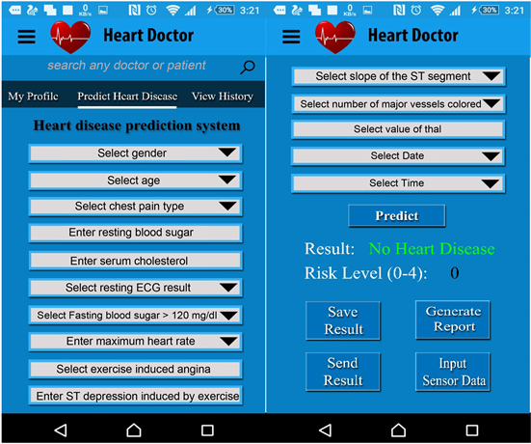

VIGNAN’S INSTITUTE OF INFORMATION TECHNOLOGY (A):: DUVVADA,VISAKHAPATNAM
Department of Computer Science and Engineering
2018-2022 Batch B.Tech Mini Project
CSE-2 :: Batch No : B-15
Project Title
Disease diagnosis (Heart diagnosis)
NAME | Register Number | ROLE
DR G.RAJENDRA | ----------------- | Guide
M.A SHANAWAZ | 18L31A05E0 | Team Lead
P.HANISHA | 18L31A05H0 | Team Member
K.K MAHEEDHAR | 18L31A05F3 | Team Member
G.PAVAN KUMAR | 18L31A05D6 | Team Member
This Photo by Unknown Author is licensed under CC BY

Slide 2
ABSTRACT OF DISEASE DIAGNOSIS
There may be an ambiguity for the people(i.e doctors) to classify the severity of certain disease,according to the severity certain aid should be given ,which may reduce the effort or expensive cost for the both customer and client.
By using certain features and entropy(i.e cosine entropy)we can classify the severity of the particular disease,by using some classification algorithms like Logistic Regression,Naïve,Bayes,Stochastic Gradient Descent,K-Nearest Neighbours,Decision Tree,Random Forest,Support Vector Machine ect. by creating an efficient algorithm we can classify the aid or precautions required for the current stage of the disease affected.
We also provide an interactive UI for the users to use and enter the features of the particular disease they want to know so that they can be aware and decide the next step,as this application can be used in an emergency.
We will use the best framework and optimal algorithms to speed up the execution time.

Slide 8
